Slide 1
Trends in Higher education
Presented by team higher ed
Michael Chopade
Ergin Bostanci
Brandon Van Nice
November 10, 2018

Slide 2
Project overview
Our goal was to investigate pertinent trends within higher education
Initially our scope was huge!
Narrowed down to admission test scores, racial disparities, and institutional economics by city/town size
Chose to compare these factors against overall graduation rate
Used large data set provided by the US Dept of Education, the College Scorecard

Slide 3

College scorecard
Among the most comprehensive databases on American colleges
Covers nearly everything imaginable
Utilized cohort data up to June 2017 (7,175 colleges represented)

Slide 4
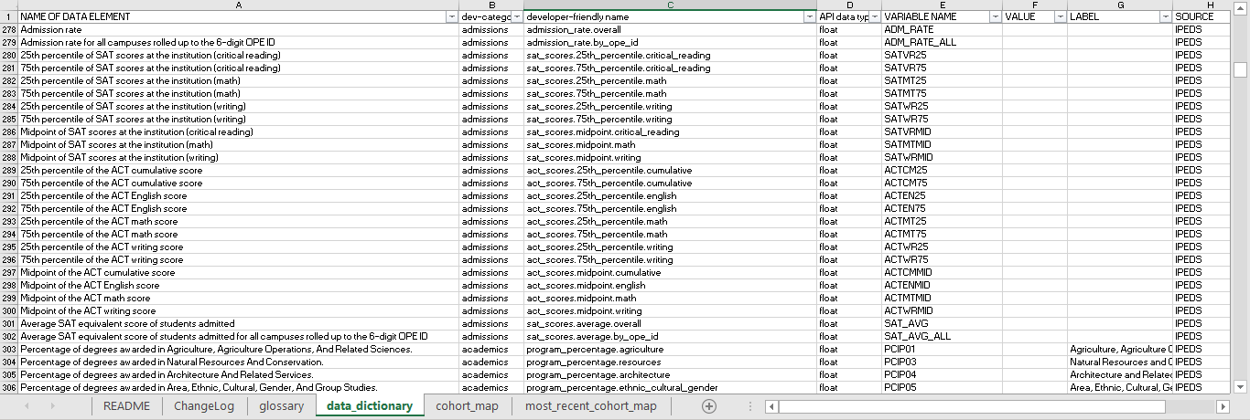
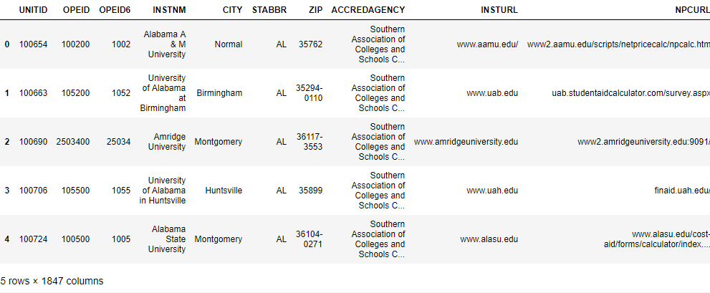

Slide 5
the test Can a score predict success in getting that degree?
By Michael chopade

Slide 6
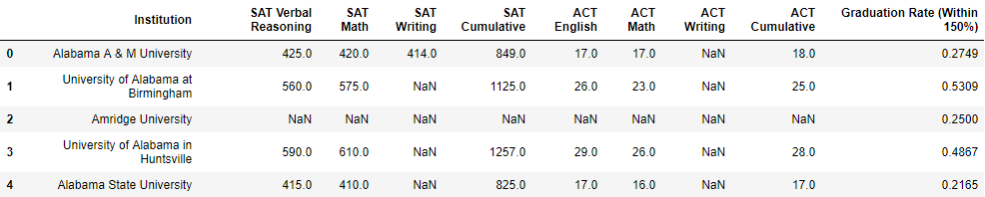
Data cleanup – make it presentable

Slide 7

Standardized Admission Tests and Graduation
Two major exams in use today:
Scholastic Aptitude/Assessment Test (SAT)
American College Testing (ACT)
Imperfect but necessary assumptions:
Test Score (Independent Variable)
Graduation Rate (Dependent Variable)
Question to answer
How strong of a predictor is a student’s test performance on their likelihood of graduation?

Slide 8
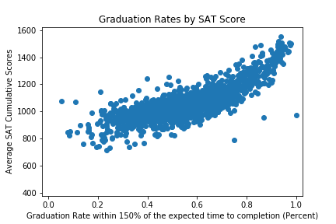
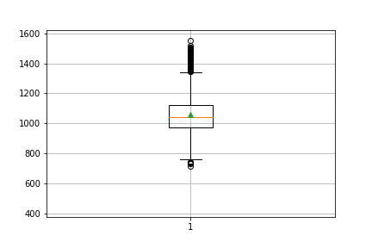
SAT Scores at a Glance
Scored from 400 to 1600
Traditionally been the more common requirement for schools on East and West coasts
Correlation of scores to graduation rate follows a parabolic curve
Limitations

Slide 9
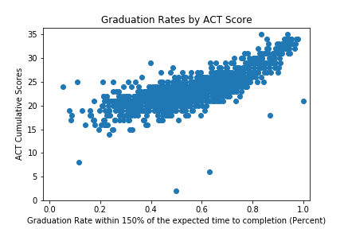
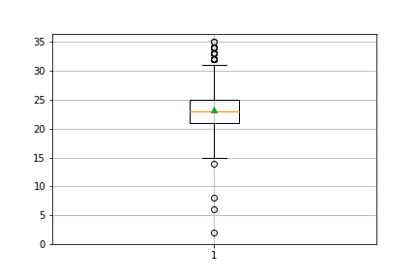
ACT Scores at a Glance
Scored from 1 to 36
Traditionally been the more common requirement for schools throughout the Midwest and South
Correlation of scores to graduation rate follows a more linear trend
Limitations
Addressing confounding variables, selectivity bias, and random error

Slide 10
Student demographics by graduation rate
by Ergin Bostanci

Slide 11
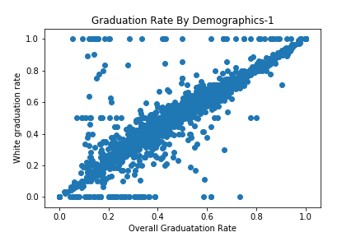
Graduation Rate Compared by Demographics
White – Overall

Slide 12
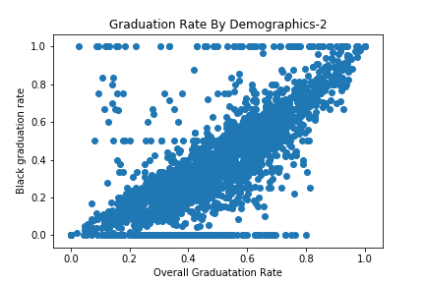
Graduation Rate Compared by Demographics
Black – Overall

Slide 13
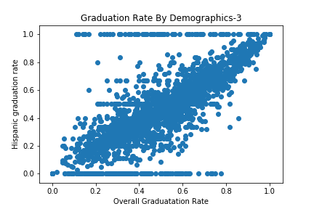
Graduation Rate Compared by Demographics
Hispanic – Overall

Slide 14
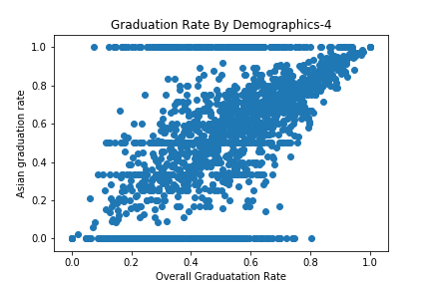
Graduation Rate Compared by Demographics
Asian – Overall

Slide 15
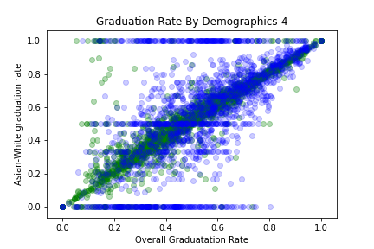
Graduation Rate Compared by Demographics
Asian is
White – Asian

Slide 16
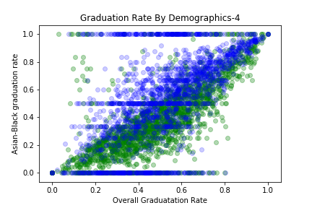
Graduation Rate Compared by Demographics
Asian is
Black – Asian

Slide 17
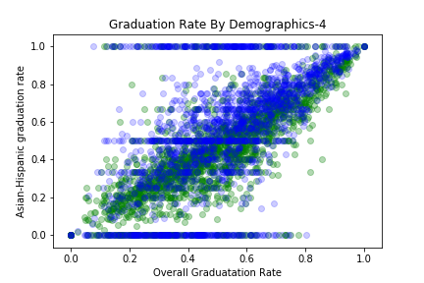
Graduation Rate Compared by Demographics
Asian is
Hispanic – Asian

Slide 18
College Graduation rates vs community size
Is there a correlation between community size and graduation rates?
By Brandon Van Nice

Slide 19
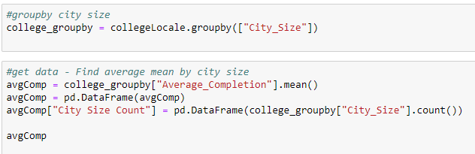
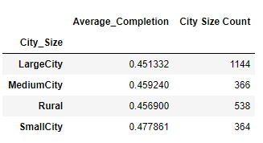
Data Clean Up and Analysis
Categorizing by City Size
Group by City Size

Slide 20
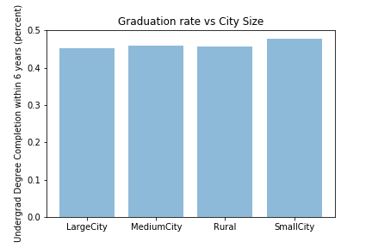
Graduation Rates by City Size
Observations:
How low the average graduation is per city size. It seems surprising that average graduation rates at 6 years are less than 50%.
Small Cities appear to have highest rate of graduation.
Limitations:
Data could be imperfect and skew to one of the categorical sizes.

Slide 21
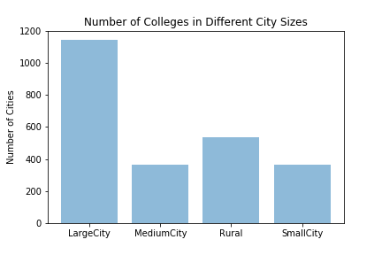
Number of Cities per category
Observations:
There are many more Colleges in Large Cities than any other size category.
Limitations:
Perhaps could have adjusted how cities were divided into different categories.

Slide 22
Discussion/Questions

